Slide 1
Concurrent transactions

Slide 2
Transaction Execution
Serial: No conflicts, consumes more time because small transactions need to wait for bigger transactions to complete.
Concurrent: Efficient method but comes up with conflicts.

Slide 3
Multiple transactions are allowed to run concurrently in the system. Advantages are:
  increased processor and disk utilization, leading to better transaction throughput: one transaction can be using the CPU while another is reading from or writing to the disk
  reduced waiting time for transactions: short transactions need not wait behind long ones.

Slide 4

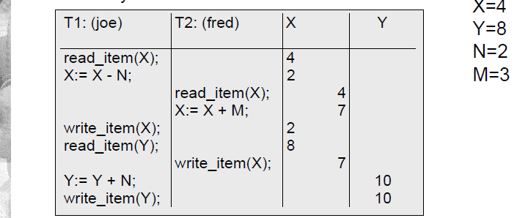
Why concurrency control is needed
The lost update problem

Slide 5
item X has incorrect value because its update from T1 is “lost” (overwritten)
T2 reads the value of X before T1 changes it in the database and hence the updated database value resulting from T1 is lost

Slide 6
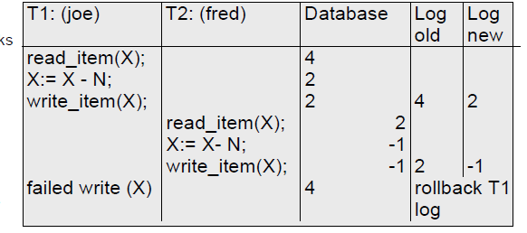
Dirty Read or Temporary Update Problem

Slide 7
One transaction updates a database item and then the transaction fails.
The updated item is accessed by another transaction before it is changed back to its original value
transaction T1 fails and must change the value of X back to its old value meanwhile T2 has read the “temporary” incorrect value of X

Slide 8
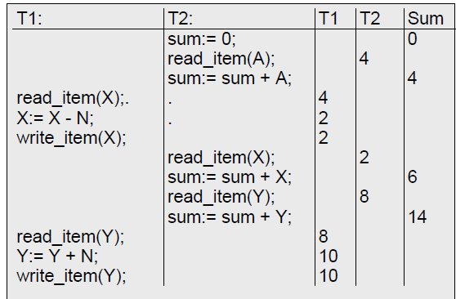
Incorrect summary problem

Slide 9
One transaction is calculating an aggregate summary function on a number of records while other transactions are updating some of these records.
The aggregate function may calculate some values before they are updated and others after.

Slide 10
Schedules
Schedules – sequences that indicate the chronological order in which instructions of concurrent transactions are executed
  a schedule for a set of transactions must consist of all instructions of those transactions
  must preserve the order in which the instructions appear in each individual transaction.

Slide 11

Example Schedules
Let T₁ transfer $50 from A to B, and T₂ transfer 10% of the balance from A to B. The following is a serial schedule (Schedule 1 in the text), in which T₁ is followed by T₂.

Slide 12

Cont.
Let T₁ and T₂ be the transactions defined previously. The following schedule is not a serial schedule, but it is equivalent to Schedule 1.

Slide 13

Cont.
The following concurrent schedule does not preserve the value of the the sum A + B.

Slide 14
Conflict operations
Two operations in a schedule are said to conflict if they satisfy all three of the following conditions:
(l) they belong to different transactions;
(2) they access the same item X; and
(3) at least one of the operations is a write_item(X).

Slide 15
Sa: r1(X); r2(X); W1(X); r1(Y); w2(X); W1(Y);
Sb: r1 (X); w1 (X); r2(X); w2(X); r1 (Y); al;

Slide 16
Recoverable Schedule
A schedule S is recoverable if no transaction T in S commits until all transactions T' that have written an item that T reads have committed.
For eg: A transaction T reads from transaction T' in a schedule S if some item X is first written by T' and later read by T. In addition, T' should not have been aborted before T reads item X, and there should be no transactions that write X after T' writes it and before T reads it (unless those transactions, if any, have aborted before T reads X).

Slide 17
Eg:
1)
Sc: r1(X); W1(X); r2(X); r1(Y); w2(X); C2; a1;
2)
Sd: r1 (X); W1 (X); r2(X); r1(Y); w2(X); W1(Y); C1; C2;
3)
Se: r1(X); W1(X); r2(X); r1(Y); W2(X); W1(Y); a1 a2;

Slide 18
Cascadeless schedule: One where every transaction reads only the items that are written by committed transactions.
Schedules requiring cascaded rollback: A schedule in which uncommitted transactions that read an item from a failed transaction must be rolled back.
Strict Schedules: A schedule in which a transaction can neither read or write an item X until the last transaction that wrote X has committed.

Slide 19
Serializability
Serial schedule: A schedule S is serial if, for every transaction T participating in the schedule, all the operations of T are executed consecutively in the schedule. Otherwise, the schedule is called nonserial schedule.
Serializable schedule: A schedule S is serializable if it is equivalent to some serial schedule of the same n transactions.

Slide 20
Result equivalent: Two schedules are called result equivalent if they produce the same final state of the database.
Conflict equivalent: Two schedules are said to be conflict equivalent if the order of any two conflicting operations is the same in both schedules.
Eg:
Sa: r1(X); r2(X); W1(X); r1(Y); w2(X); W1(Y);
Sb: r1 (X); w1 (X); r2(X); w2(X); r1(Y); al;

Slide 21
Types of Serializability
Conflict Serializability
View Serializability

Slide 22
Conflict Serializability
A schedule is said to be conflict serializable if it is equivalent to some serial schedule.
We can check for Conflict Serializability by two ways:
By swapping operations to check whether is converted into serial schedule or not
By precedence Graph Method

Slide 23
Consider a following schedule
T1 | T2
Read(x) Write(x)
 | Read(x) Write(X)
read (Y); write (Y);

Slide 24
Check the above schedule is conflict serializable or not using swapping method.

Slide 25
Check for conflict Serializability
T1 | T2
read_item(X);
 | read_item(X);
write_item(X); read_item(Y);
 | write_item(X);
write_item(Y);

Slide 26

Check for conflict serializability

Slide 27
Precedence Graph Method
Rules for Precedence Graph:
Where transaction A writes to an attribute which transaction B has read from, draw an line pointing from B to A.
Where transaction A writes to an attribute which transaction B has written to, draw a line pointing from B to A.
Where transaction A reads from an attribute which transaction B has written to, draw a line pointing from B to A.

Slide 28
Example:
TRAN1 | TRAN 2
READ(A) READ(B)
 | READ(A) READ(B)
WRITE(B)
 | WRITE(B)

Slide 29
TRAN 1 | TRAN 2 | TRAN 3
READ(A) READ(B)
 | READ(A) READ(B)
 |  | WRITE(A)
WRITE( C) WRITE(B)
 |  | WRITE( C)

Slide 30
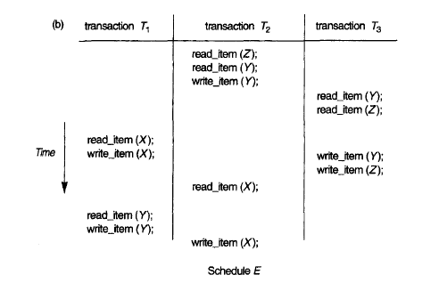

Slide 31
View seriazability
Let S and S´ be two schedules with the same set of transactions. S and S´ are view equivalent if the following three conditions are met:
  1. For each data item Q, if transaction T_{i} reads the initial value of Q in schedule S, then transaction T_{i} must, in schedule S´, also read the initial value of Q.
  2. For each data item Q if transaction T_{i} executes read(Q) in schedule S, and that value was produced by transaction T_{j} (if any), then transaction T_{i} must in schedule S´ also read the value of Q that was produced by transaction T_{j} .
  3. For each data item Q, the transaction (if any) that performs the final write(Q) operation in schedule S must perform the final write(Q) operation in schedule S´.

Slide 32
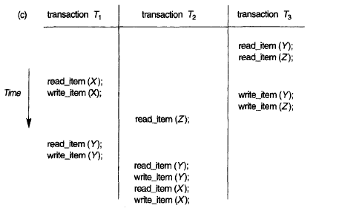
example

Slide 33
Example:
S: r1 (X); w1 (X); r2(Y); w2(Y); r1 (Y); W1(Y); r2(X); w2(X);
S1: rl (X); r2 (2); rl (2); r3 (X); r3 (Y); WI (X); W3 (Y); r2 (Y); W2 (2); W2 (Y);

